Slide 1

Multi-Excitation Raman Spectroscopy for Label-Free, Strain-Level Characterization of Bacterial Pathogens in Artificial Sputum Media
Adam P. Lister, Callum J. Highmore, Niall Hanrahan, James Read, Alasdair P. S. Munro, Samuel Tan, Raymond N. Allan, Saul N. Faust, Jeremy S. Webb, and Sumeet Mahajan
Analytical Chemistry 2022 | DOI: 10.1021/acs.analchem.1c02501 | January 3rd 2022

Slide 2
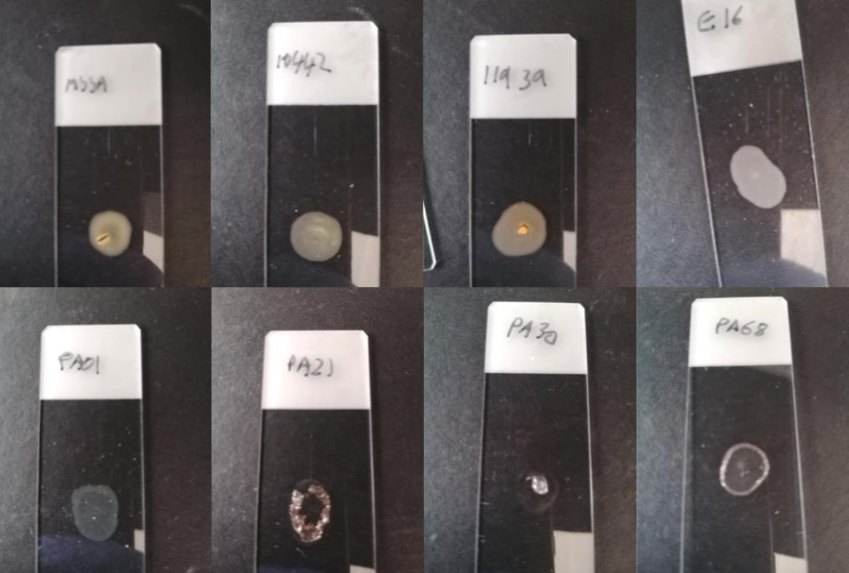
Outline
Concept of the study
Key findings:
Differentiation from single wavelength with PCA
Differences between 532 nm and 785 nm
Differentiation from combined wavelengths with PCA, SVM
Sputum samples
Issues with the study
My takeaways for our work

Slide 3

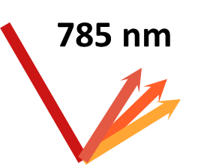
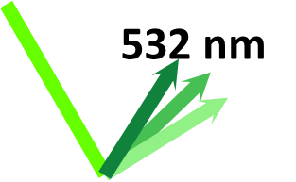
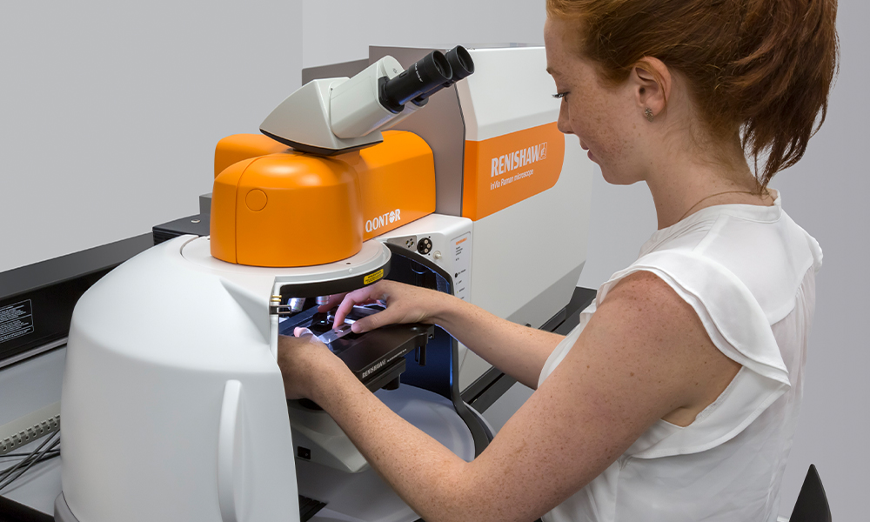
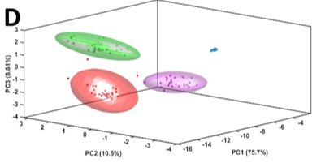
Concept of the study: Methodology
1
2
S. aureus (SA)
S. epidermidis
P. aeruginosa (PA)
P. fluorescens
X 4 Strains each
+ 1 other species
Pellet dried
on quartz
Grow in LB
Wash X2
3
4
785 nm
PCA
532 nm
SVM
Renishaw InVia Raman Microscope

Slide 4
Concept of the study: Research questions
785 nm
532 nm
S. aureus (SA)
P. aeruginosa (PA)
Is one wavelength better than the other? Why?
Can you differentiate between the different strains?
Can we combine both wavelengths? Will it improve anything?
Does this work also for sputum samples?

Slide 5
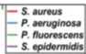


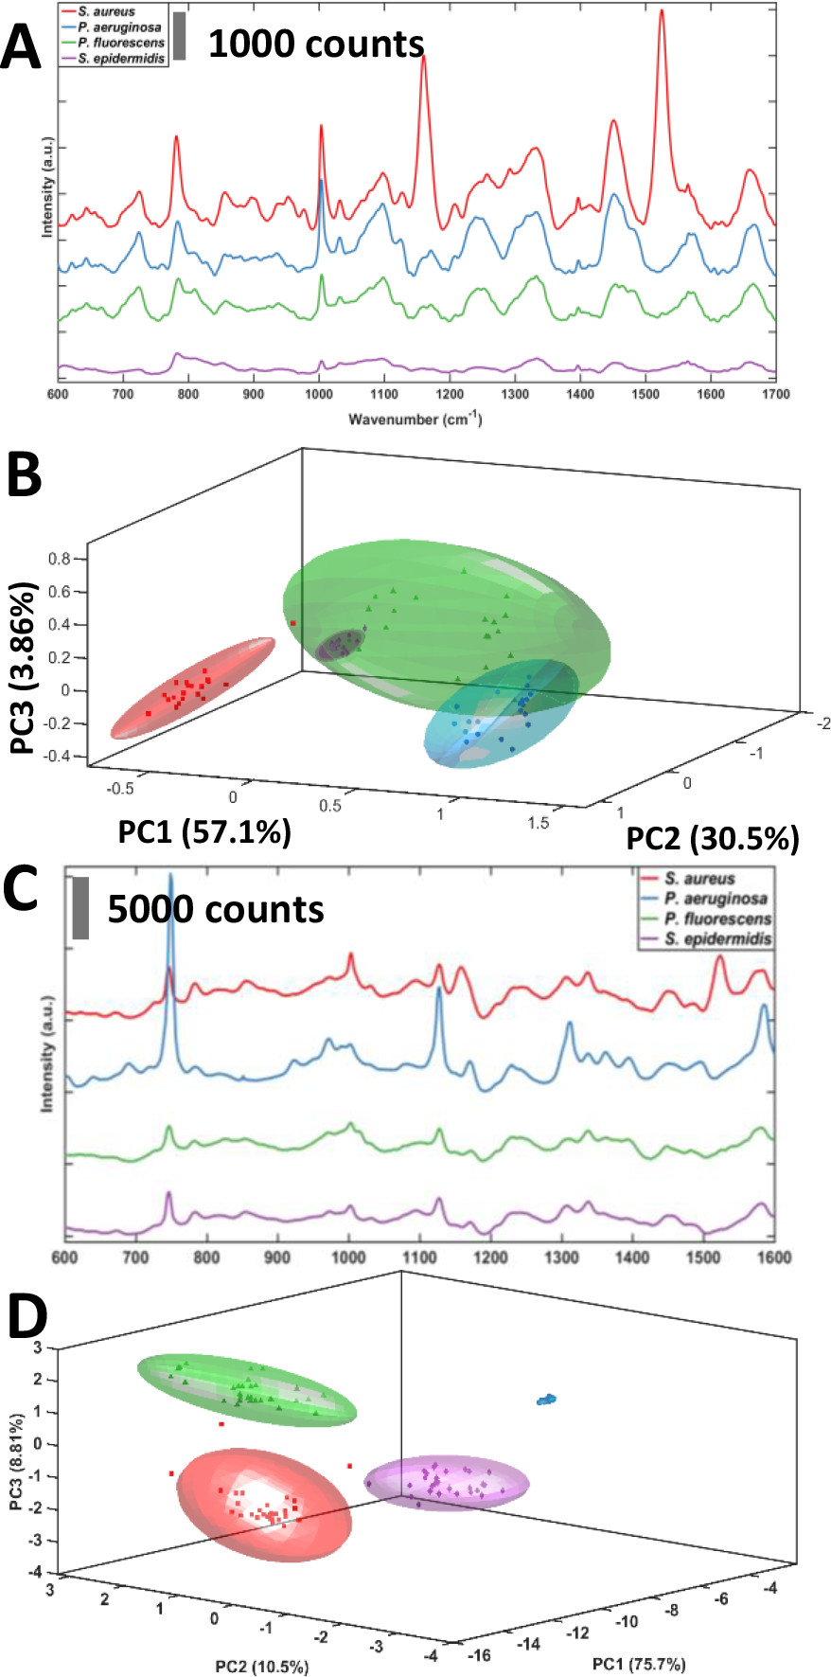
Can you differentiate between the different species?
S. aureus
P. Aeruginosa
P. Fluorescens
S. epidermidis
785 nm
532 nm
With 785: Okay-ish
With 532: yes
Notes:
Figure 2. (A) Offset, class mean spontaneous Raman spectra of four bacterial species at 785 nm excitation: Staphylococcus aureus, Staphylococcus epidermidis, Pseudomonas aeruginosa, and Pseudomonas fluorescens. (B) Plot of the first three principal components showing the clustering of bacterial spectra from A along species lines. Colored envelopes represent the 95% confidence envelope for the corresponding species. Clear grouping based on species is visible. (C) Offset, class mean spontaneous Raman spectra of four bacterial species at 532 nm excitation: Staphylococcus aureus, Staphylococcus epidermidis, Pseudomonas aeruginosa, and Pseudomonas fluorescens. (D) Plot of the first three principal components showing the clustering of bacterial spectra from C along species lines. Colored envelopes represent the 95% confidence envelope for the corresponding species. Clear grouping based on species is visible.

Slide 6


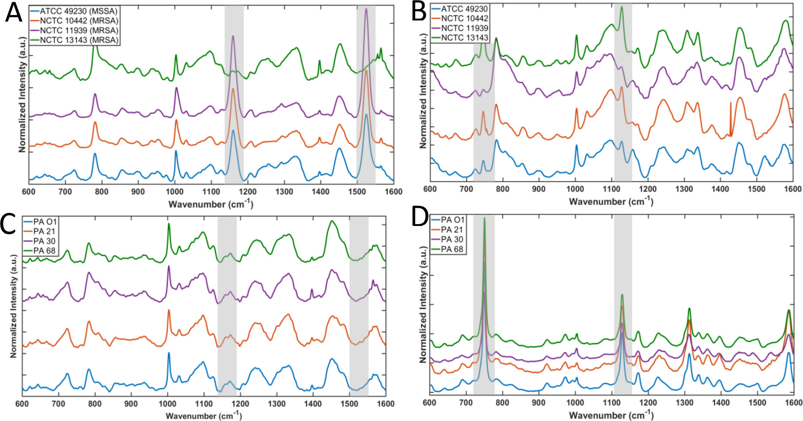


1. Is one wavelength better than the other? Why?
785 nm
532 nm

Slide 7
1. Is one wavelength better than the other? Why?
785 nm
532 nm

Slide 8
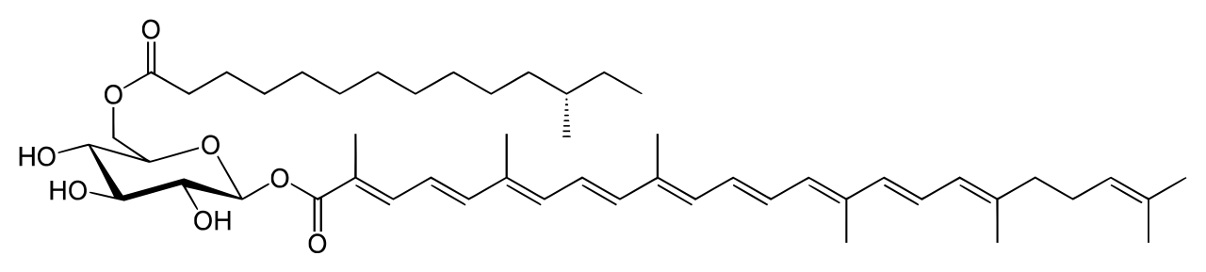
For SA: carotenoid peaks appear with 785 nm
785 nm
1150 cm^{–1} and 1520 cm^{–1} are attributed to the C–C and C=C vibration modes present in carotenoids. Specifically: Staphyloxantine

Slide 9
For SA: carotenoid peaks appear with 785 nm, the peaks are at the right position
785 nm
My carotene spectrum from
Advanced Charactarization course
1150 cm^{–1} and 1520 cm^{–1} are attributed to the C–C and C=C vibration modes present in carotenoids. Specifically: Staphyloxantine

Slide 10
As expected: Carotenoids make the bacteria orange
785 nm
My carotene spectrum from
Advanced Charactarization course
1150 cm^{–1} and 1520 cm^{–1} are attributed to the C–C and C=C vibration modes present in carotenoids. Specifically: Staphyloxantine

Slide 11
The one strain that isn’t orange, doesn’t show these peaks
785 nm
My carotene spectrum from
Advanced Charactarization course
1150 cm^{–1} and 1520 cm^{–1} are attributed to the C–C and C=C vibration modes present in carotenoids. Specifically: Staphyloxantine

Slide 12

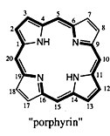
For PA: porphyrin peaks appear with 532 nm
532 nm
We attribute the strongly enhanced vibrational modes around 750 cm^{–1} and 1120 cm^{–1} to ring breathing and half ring modes of porphyrins

Slide 13
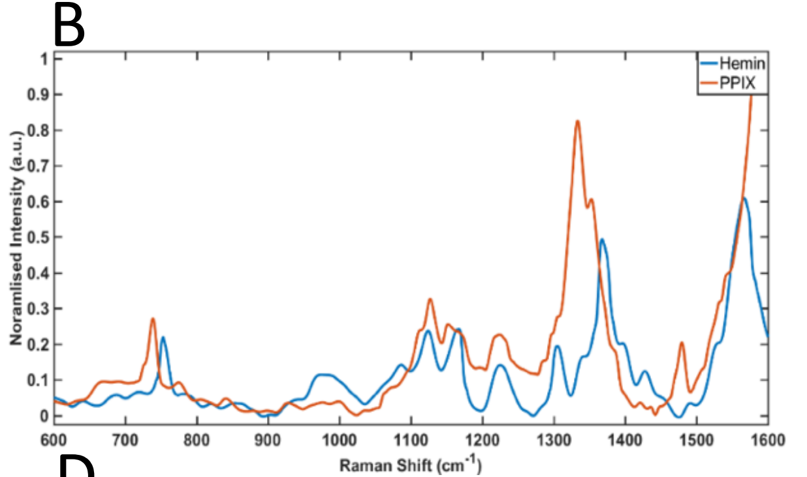
For PA: porphyrin peaks appear with 532 nm, the peaks fit pure spectra
532 nm
From Figure S4(B): Spectra of pure porphyrins
We attribute the strongly enhanced vibrational modes around 750 cm^{–1} and 1120 cm^{–1} to ring breathing and half ring modes of porphyrins

Slide 14
In summary: each wavelength is suitable for a different bacterium – but WHY?
785 nm
532 nm

Slide 15
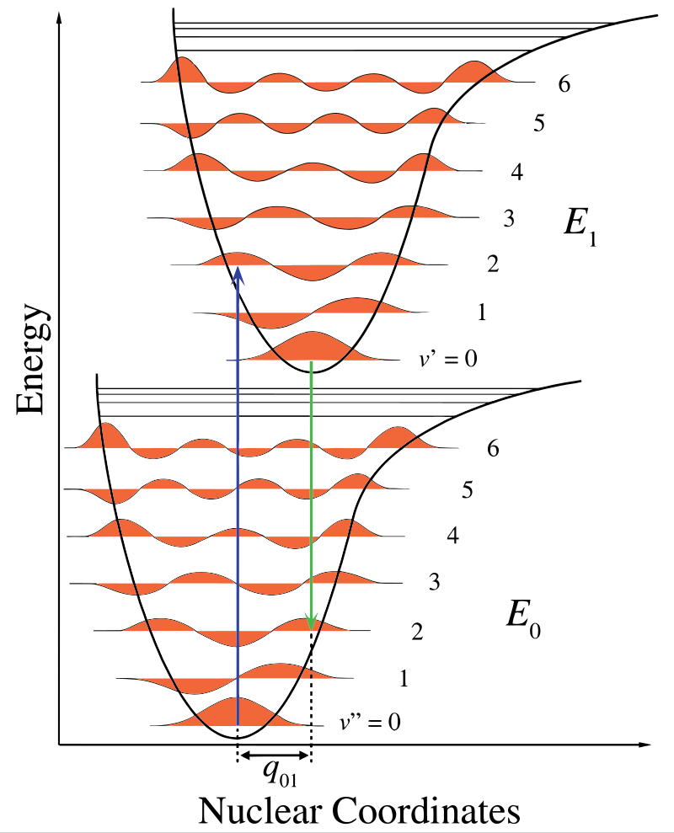
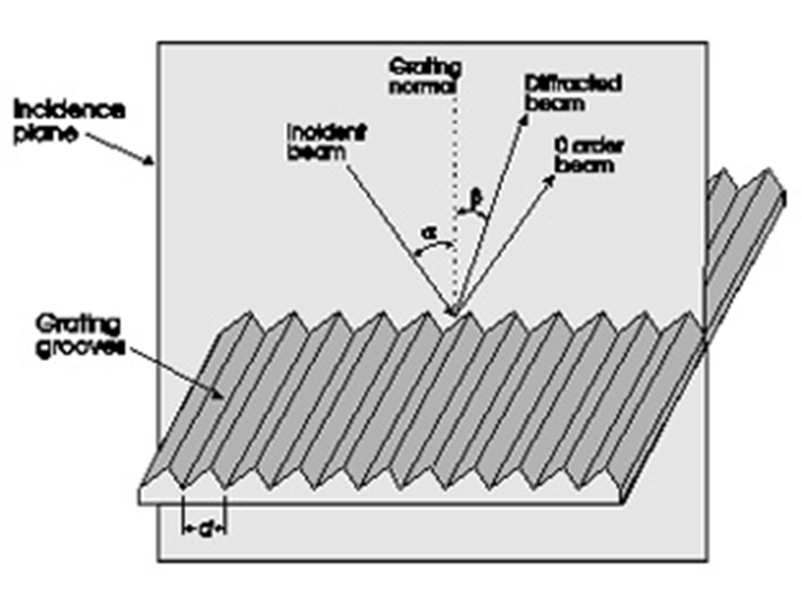

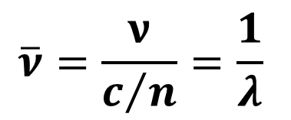
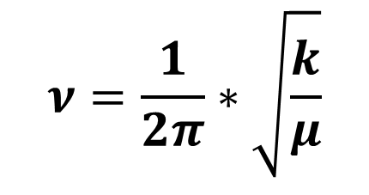

Key Takeaways: Wavelength…
From my last talk, we spoke about resonance enhanced signals
Doesn’t affect peak position
Significantly affects peak intensity
Affects spectral resolution
$$ν=\frac{1}{2π}∗\sqrt{\frac{k}{μ}}$$
$$I_{R}∝ν^{4}$$
Resonance
$$\overline{ν}=\frac{ν}{c/n}=\frac{1}{λ}$$
👆🏼

Slide 16
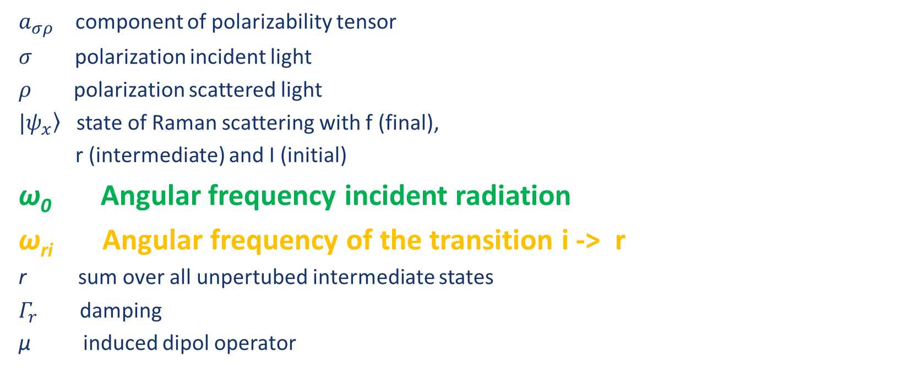
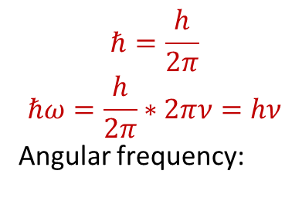
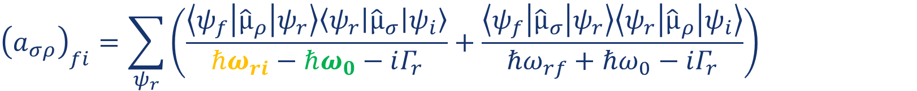
For specific molecules, the polarizability factor can be huge
$$I_{Stokes}=constant∙I_{0 }{\left(ω_{0}−ω_{R}\right)}^{4}∙{\left|a\right|}^{2}$$
$${\left(a_{σρ}\right)}_{fi}=\sum_{ψ_{r}}{\left(\frac{\left\langle ψ_{f} | {\hat{µ}}_{ρ} | ψ_{r}\right\rangle \left\langle ψ_{r} | {\hat{µ}}_{σ} | ψ_{i}\right\rangle }{ℏω_{ri}−ℏω_{0}−iΓ_{r}}+\frac{\left\langle ψ_{f} | {\hat{µ}}_{σ} | ψ_{r}\right\rangle \left\langle ψ_{r} | {\hat{µ}}_{ρ} | ψ_{i}\right\rangle }{ℏω_{rf}+ℏω_{0}−iΓ_{r}}\right)}$$
$$ℏ=\frac{h}{2π}$$
$$ℏω=\frac{h}{2π}∗2πν=hν$$
Angular frequency:
$a_{σρ}$ component of polarizability tensor
$σ$ polarization incident light
$ρ$ polarization scattered light
$|\left.ψ_{x}\right\rangle$ state of Raman scattering with f (final),
r (intermediate) and I (initial)
ω₀ Angular frequency incident radiation
ω_{ri} Angular frequency of the transition i -> r
r sum over all unpertubed intermediate states
$Γ_{r}$ damping
µ induced dipol operator
Laser frequency
Molecule’s vibrational frequency
J. Popp, V. V. Tuchin, A. Chiou and S. H. Heinemann, Handbook of Biophotonics, John Wiley & Sons, 2011

Slide 17
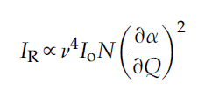
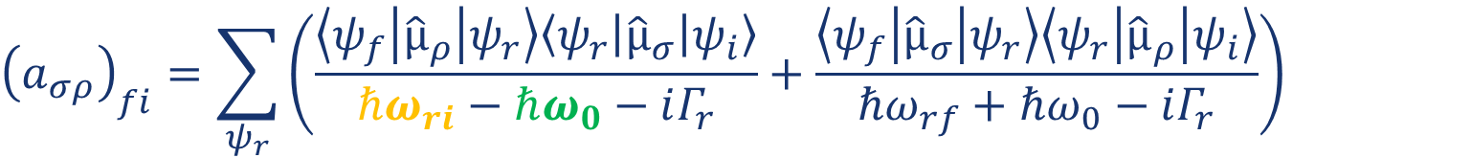
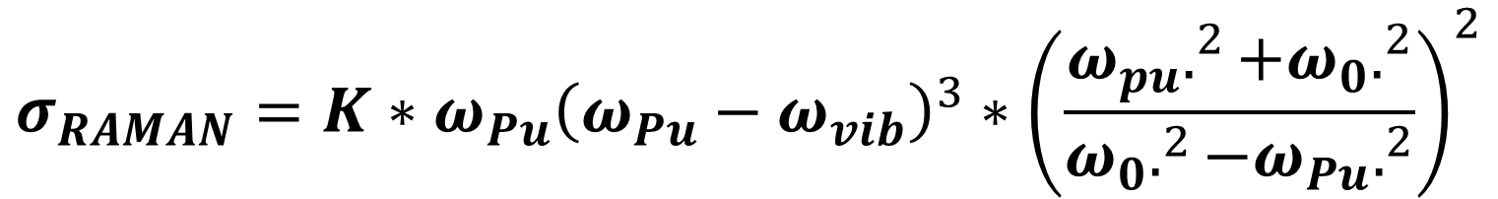
$$I_{Stokes}=constant∙I_{0 }{\left(ω_{0}−ω_{R}\right)}^{4}∙{\left|a\right|}^{2}$$
👈🏼From Petra’s presentations
$${\left(a_{σρ}\right)}_{fi}=\sum_{ψ_{r}}{\left(\frac{\left\langle ψ_{f} | {\hat{µ}}_{ρ} | ψ_{r}\right\rangle \left\langle ψ_{r} | {\hat{µ}}_{σ} | ψ_{i}\right\rangle }{ℏω_{ri}−ℏω_{0}−iΓ_{r}}+\frac{\left\langle ψ_{f} | {\hat{µ}}_{σ} | ψ_{r}\right\rangle \left\langle ψ_{r} | {\hat{µ}}_{ρ} | ψ_{i}\right\rangle }{ℏω_{rf}+ℏω_{0}−iΓ_{r}}\right)}$$
👈🏼From Larkin book
$$σ_{RAMAN}=K∗ω_{Pu}{\left(ω_{Pu}−ω_{vib}\right)}^{3}∗{\left(\frac{ω_{pu}.^{2}+ω_{0}.^{2}}{ω_{0}.^{2}−ω_{Pu}.^{2}}\right)}^{2}$$
👈🏼From Paper
σ_{RAMAN} : The Raman scattering cross-section
K: frequency independent factors
ω_{Pu}: “Pump” frequency (excitation)
ω₀: frequency of the molecular absorption peak
ω_{vib}: vibrational transition energy

Slide 18
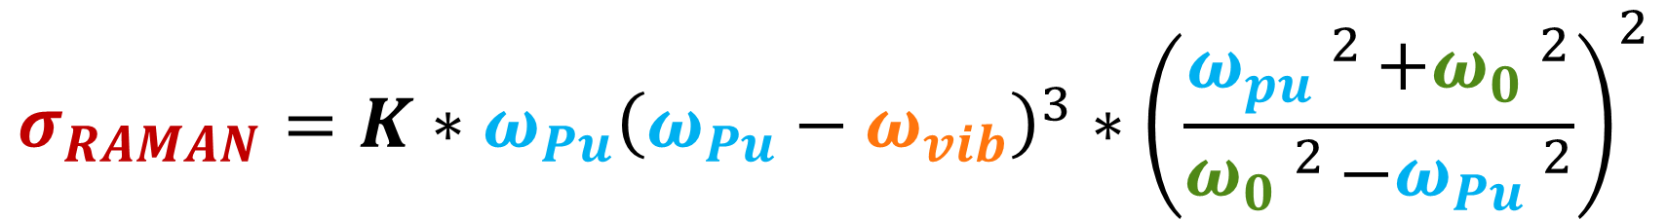
Why do different peaks appear with different excitation? Because of the scattering cross-section
$$σ_{RAMAN}=K∗ω_{Pu}{\left(ω_{Pu}−ω_{vib}\right)}^{3}∗{\left(\frac{ω_{pu}.^{2}+ω_{0}.^{2}}{ω_{0}.^{2}−ω_{Pu}.^{2}}\right)}^{2}$$
σ_{RAMAN} : The Raman scattering cross-section
K: frequency independent factors
ω_{Pu}: “Pump” frequency (excitation)
ω₀: frequency of the molecular absorption peak
ω_{vib}: vibrational transition energy

Slide 19
Why do different peaks appear with different excitation? Because of the scattering cross-section
$$σ_{RAMAN}=K∗ω_{Pu}{\left(ω_{Pu}−ω_{vib}\right)}^{3}∗{\left(\frac{ω_{pu}.^{2}+ω_{0}.^{2}}{ω_{0}.^{2}−ω_{Pu}.^{2}}\right)}^{2}$$
σ_{RAMAN} : The Raman scattering cross-section
K: frequency independent factors
ω_{Pu}: “Pump” frequency (excitation)
ω₀: frequency of the molecular absorption peak
ω_{vib}: vibrational transition energy
This equation makes it clear that when the pump wavelength is near to, or at, the absorption maximum, the Raman cross-section increases, and therefore, the signal increases, giving the pre-resonance or the resonant effect, respectively.

Slide 20
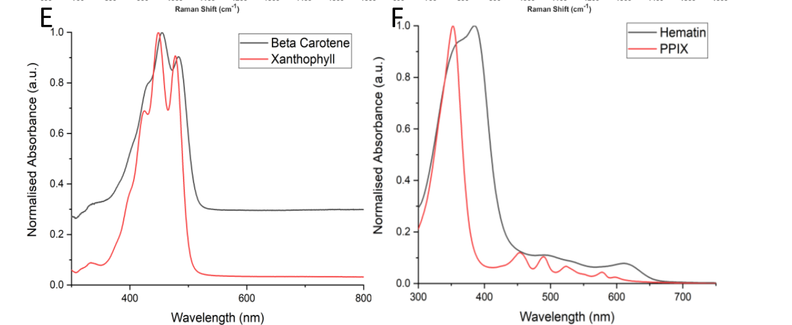
To prove this, they show absorbance spectra of pure substances:
Carotenes:
Beta: 455, 484 nm
Xantho: 425, 448, 478 nm
Porphyrins:
PPIX: 358 nm
Hematin: 353 nm
Figure S4(E-F): Normalised UV-Visible absorbance spectra

Slide 21
We now know that different wavelengths are suited for different bacteria Now, can we combine them?
785 nm
532 nm
S. aureus (SA)
P. aeruginosa (PA)
Is one wavelength better than the other? Why?
Can you differentiate between the different strains?
Can we combine both wavelengths? Will it improve anything?
Does this work also for sputum samples?

Slide 22
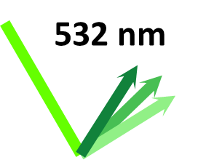

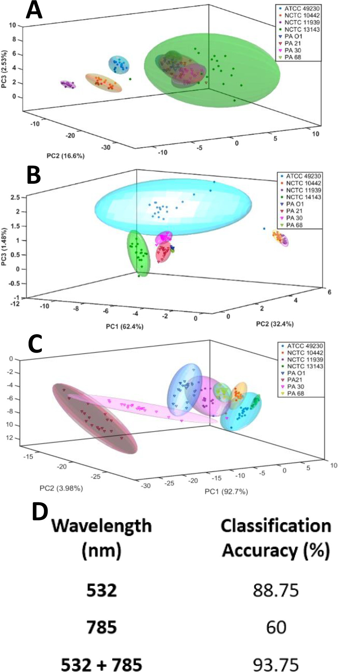
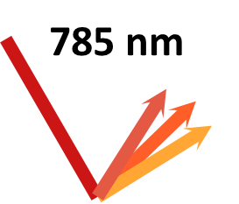
Can we combine them both? Will it improve anything?

Slide 23
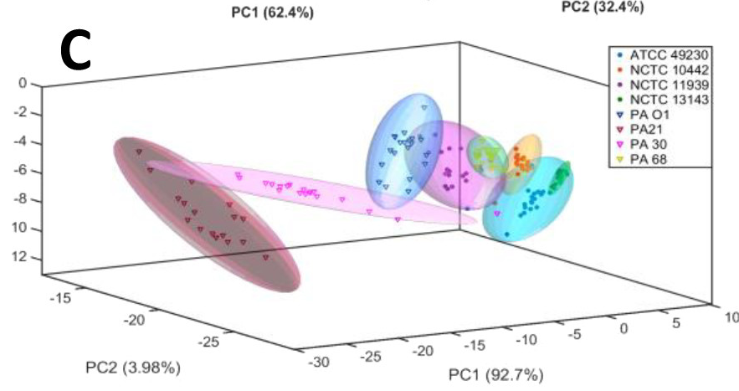
By using the combined spectra, classification improves dramatically
Classify the 8 strains with PCA*
λ | Classification Accuracy [%]
 | 88.75
 | 60
 | 93.75
From figure 4
* Any spectra that appeared outside of the confidence or within multiple confidence intervals of the same or different strains were regarded as unsuccessful.

Slide 24
By using the combined spectra, classification improves dramatically
Classify the 8 strains with PCA*
λ | Classification Accuracy [%]
 | 88.75
 | 60
 | 93.75
From figure 4
* Any spectra that appeared outside of the confidence or within multiple confidence intervals of the same or different strains were regarded as unsuccessful.
This result is only if they DON’T remove background❗❗❗

Slide 25
A lot of the information comes from the background
λ | Raw spectrum | Processed (Background removed) | Only Background
 | 88.75 | 92.50 | 73
 | 60.00 | 60.00 | 59.38
 | 93.75 | 48.33* | 59.38**
* Source: Figure S7
** I think this number might be a mistake in publication. There are a few. (source: figure S8, page E top left)

Slide 26
Using SVM improved classification significantly
λ | PCA | SVM | PCA-SVM 10 PCs
 | 88.75 | 97.38 | ~96*
 | 60.00 | 97.52 | ~97.1*
 | 93.75 | 98.64 | ~97.7*
PCA
Unsupervised
SVM
Supervised

Slide 27
PCA-SVM is not as good, maybe because some of the information is not in the first 10 PCs
λ | PCA | SVM | PCA-SVM 10 PCs
 | 88.75 | 97.38 | ~96*
 | 60.00 | 97.52 | ~97.1*
 | 93.75 | 98.64 | ~97.7*
PCA
* I had to calculate these numbers by hand from their tables, they are problematic, we’ll discuss later
Unsupervised
SVM
Supervised

Slide 28
Concept of the study
785 nm
532 nm
S. aureus (SA)
P. aeruginosa (PA)
Is one wavelength better than the other? Why?
Can you differentiate between the different strains?
Can we combine both wavelengths? Will it improve anything?
Does this work also for sputum samples?

Slide 29
Does this work also for sputum samples?
10 µL
Artificial Sputum Medium (ASM):
mucin from pig stomach mucosa 5 g/L
salmon sperm DNA 4 g/L
diethylene triamine pentaacetic acid 5.9 mg/L
NaCl 5 g/L
KCl 2.2 g/L
Tris Base 1.81 g/L
egg yolk emulsion 5 mL/L
casamino acids 5 g/L
For sputum measurements:
bacterial pellet + ASM at 1:1 v/v
10 µL
ASM
Bacterial pellet
Spiked Sample
Smear and dry
on quartz

Slide 30
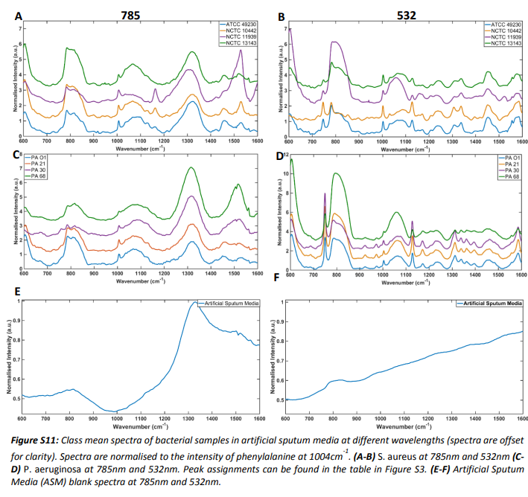
When observing the spectra – the sputum has a very strong background
785 nm
532 nm
S. aureus (SA)
P. aeruginosa (PA)
ASM

Slide 31
But somehow the classification is even better with the sputum
785 nm
532 nm
SVM Classification (strains)
λ | Classification Accuracy [%]
 | 94.4
 | 98.33
 | 99.75
S. aureus (SA)
P. aeruginosa (PA)
ASM

Slide 32
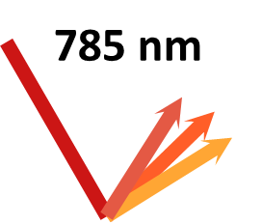
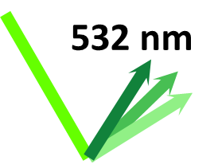
The spectra with the sputum lose a lot of the “pre-resonant” peaks
Pure Bacteria (Fig. 3)
Bacteria in sputum (Fig. S11)

Slide 33

Focusing first on P. aeruginosa
+
P. aeruginosa (PA)
P. aeruginosa (PA)
Pure Bacteria (Fig. 3)
Bacteria in sputum (Fig. S11)

Slide 34
Same reduction in resonance with S. aureus
+
S. aureus (SA)
S. aureus (SA)
Pure Bacteria (Fig. 3)
Bacteria in sputum (Fig. S11)

Slide 35
Summary:
785 nm
532 nm
S. aureus (SA)
P. aeruginosa (PA)
Is one wavelength better than the other? Why?
Can you differentiate between the different strains?
Can we combine both wavelengths? Will it improve anything?
Does this work also for sputum samples?

Slide 36
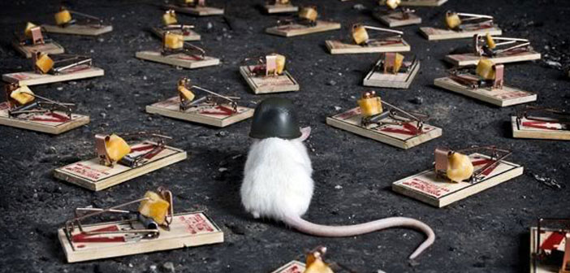
Let’s talk about the issues

Slide 37
1. The amount of data:
2. The cross-validation
10-fold cross validation
Leave One Batch Out Cross Validation
LOBOCV
S. aureus (SA)
P. aeruginosa (PA)
X 4 Strains each
Each sample was measured ONCE, collecting 30 spectra
The entire dataset included: 240 Spectra
They used 10-fold cross validation
What does this mean?
It means they’re validating the model on the same batch they measured – if any external factor is affecting the spectra, it will go into the model
There are no replications → Overfitting
The results are very biased → Overfitting

Slide 38


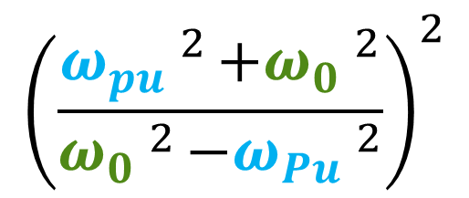
3. Carotenoids are resonance enhanced with 532 nm, not 785 nm
Figure S4
785 nm
Peaks:
Beta: 455, 484 nm
Xantho: 425, 448, 478 nm
1150 cm^{–1} and 1520 cm^{–1} are attributed to the C–C and C=C vibration modes present in carotenoids. Specifically: Staphyloxantine
$${\left(\frac{ω_{pu}.^{2}+ω_{0}.^{2}}{ω_{0}.^{2}−ω_{Pu}.^{2}}\right)}^{2}$$
“…when the pump wavelength is near to, or at, the absorption maximum, the Raman cross-section increases…”
Notes:
Of interest in these spectra is the observation of carotenoid pre-resonance at 785 nm and its absence at 532 nm. It is common in studies of carotenoid species to use excitations in the range of 488 nm, as these are known to provide strong enhancement of these molecules; however, the broad absorbance of many carotenoids extends up to around 500 nm wavelengths (38−40) and should therefore be pre-resonant with 532 nm excitation. (38) The use of 785 nm excitation for this purpose is uncommon, but large Raman peaks associated with carotenoids in SA and a narrow subset of strains of the related S. epidermidis have been detected at 785 nm. (41)

Slide 39
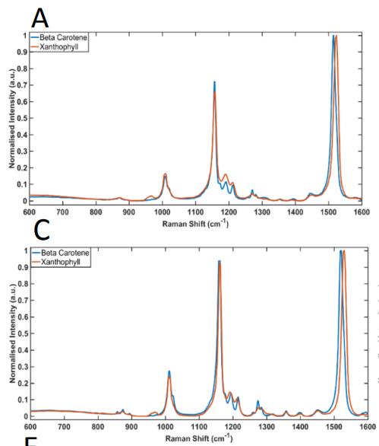
3. Carotenoids are resonance enhanced with 532 nm, not 785 nm
Figure S4
785 nm
Peaks:
Beta: 455, 484 nm
Xantho: 425, 448, 478 nm
532 nm
Figure S.4 The pure carotenoids look the same with both wavelengths

Slide 40

4. Porphyrins have 4 peaks, they only discuss 2
Spectra of P. aeruginosa
Spectra of pure porphyrins
If the source is indeed porphyrins, then where are the peaks at ~1300 and ~1580?
Why are they smaller that 750?
“We attribute the strongly enhanced vibrational modes around 750 cm^{–1} and 1120 cm^{–1} to ring breathing and half ring modes of porphyrins”
Idea: maybe background correction is wrong?

Slide 41
5. Some more small things…
No standard deviations are shown
No spectral resolution
No laser intensity
Wavenumber calibration is not clear (to me)
Their background peak (from the quartz slide) is very different across measurements
They made mistakes in the supplementary figure descriptions
Their conclusion: They claim this method can be used to detect antibiotic resistance, from a single strain being differentiated (one of which has no carotens!)!
Overall: very problematic paper

Slide 42
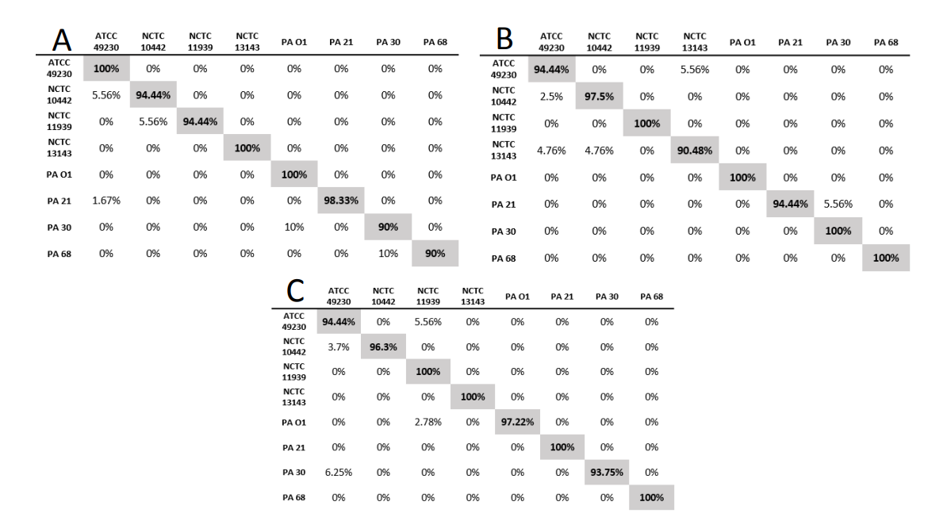
6. The numbers don’t add up
In figure S9 they give a confusion matrix for classification with PCA-SVM
Assuming each strain has 30 spectra, it is not possible to have 5.56% misclassified (not a valid division of 30)
Same for: 1.67, 4.76, 3.7, 2.78, 6.25
Each misclassification in 30 samples = 1/30 = 0.0333 = 3.33%
Same issue in figures S12 (which reproduces Fig 5 in numbers), S13

Slide 43
6. The numbers don’t add up II
The entire dataset included: 240 Spectra
(quote: “Two-hundred forty spectra were used to train the SVM classified (30 for each strain), and the same number of spectra was used for validation”)
For each misclassification, you lose 1/240 = 0.4166% in accuracy
It is not possible to get 99.75% accuracy: if 1 spectrum is misclassified you get 99.58% accuracy.
Also for 94.4%. Not possible with 240 spectra. You can get: 94.6, 94.2
98.33% is possible, with 4/240 misclassified spectra
SVM Classification (strains)
λ | Classification Accuracy [%]
 | 94.4
 | 98.33
 | 99.75

Slide 44
My takeaways for our work
It’s good that we have proper controls
Check your background subtraction methods
Double check your classification results, did you lose or gain spectra “out of nowhere”?
There is information “hiding” in fluorescence, this might be usable
Read carefully what people did: it’s very easy to write titles and abstracts

Slide 45
THANK YOU FOR YOUR ATTENTION
Let’s discuss the issues

Slide 46
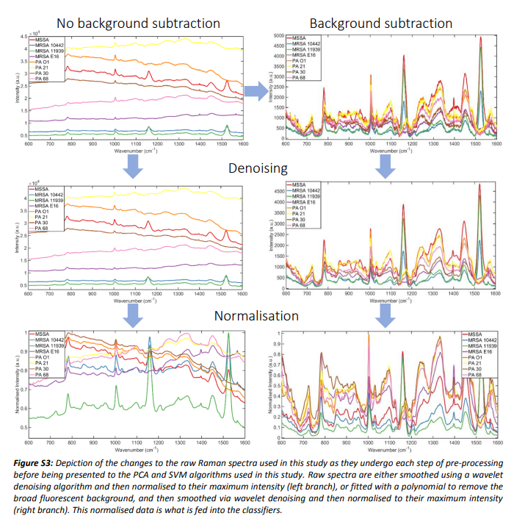

Slide 47
Figure S3

Slide 48
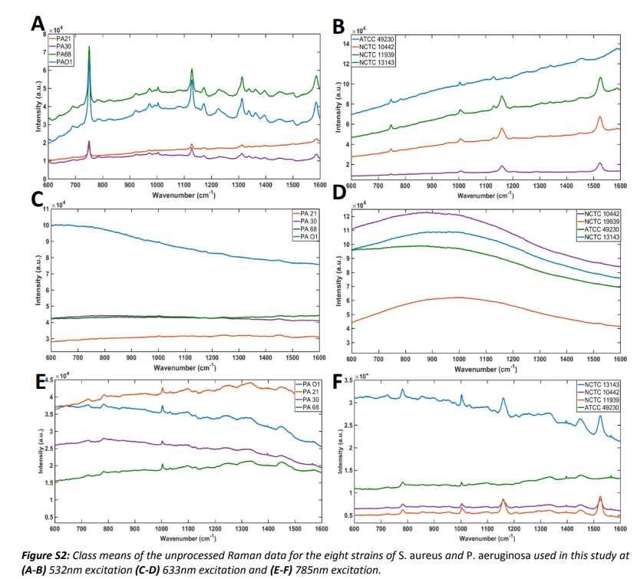

Slide 49
Total Spectra | 240
 |  | % Correct | % Miss
Correctly classified | 240 | 100.00% | 0.00%
 | 239 | 99.58% | 0.42%
 | 238 | 99.17% | 0.83%
 | 237 | 98.75% | 1.25%
 | 236 | 98.33% | 1.67%
 | 235 | 97.92% | 2.08%
 | 234 | 97.50% | 2.50%
 | 233 | 97.08% | 2.92%
 | 232 | 96.67% | 3.33%
 | 231 | 96.25% | 3.75%
 | 230 | 95.83% | 4.17%
 | 229 | 95.42% | 4.58%
 | 228 | 95.00% | 5.00%
 | 227 | 94.58% | 5.42%
 | 226 | 94.17% | 5.83%
 | 225 | 93.75% | 6.25%
 | 224 | 93.33% | 6.67%
 | 223 | 92.92% | 7.08%
Total Spectra | 30
 |  | % Correct | % Miss
Correctly classified | 30 | 100.00% | 0.00%
 | 29 | 96.67% | 3.33%
 | 28 | 93.33% | 6.67%
 | 27 | 90.00% | 10.00%
 | 26 | 86.67% | 13.33%
 | 25 | 83.33% | 16.67%
 | 24 | 80.00% | 20.00%
 | 23 | 76.67% | 23.33%
 | 22 | 73.33% | 26.67%
 | 21 | 70.00% | 30.00%
 | 20 | 66.67% | 33.33%
 | 19 | 63.33% | 36.67%
 | 18 | 60.00% | 40.00%
 | 17 | 56.67% | 43.33%
 | 16 | 53.33% | 46.67%
 | 15 | 50.00% | 50.00%
 | 14 | 46.67% | 53.33%
 | 13 | 43.33% | 56.67%

